Slide 1


Chapter One
Introduction to Labour Market Economics
Prepared by Dr. Mir Ahasan Kabir
York University

Slide 2
Learning Objectives
Understand that earnings, hours, and hourly wages are quite unevenly distributed in the Canadian labour market.
See that, as in other markets, supply and demand curves can be used to find the equilibrium values of wages and employment levels.
Understand that, in addition to market forces, legislative and institutional factors play an important role in labour market outcomes.
Learn about the different types of data sets, such as time-series data, cross-section microdata, and panel data, that are used in labour market research.
Learn how regression analysis, and other econometric techniques, contribute to our understanding of labour economics.
© 2021 MCGRAW-HILL EDUCATION LIMITED.
1-<number>

Slide 3
Main Questions
Who are the main actors in the labour market, and what particular roles do they play?
How can features of the labour market be divided into labour supply and labour demand factors, as well as into the interaction of supply and demand?
What types of policy questions does labour economics address?
What characteristics of the labour market make it distinctive from other markets, justifying a special sub-discipline of economics?
What is the neoclassical model of the labour market? Are there alternative approaches?
© 2021 MCGRAW-HILL EDUCATION LIMITED.
1-<number>

Slide 4
Main Players and their Roles
Individuals’ Decisions
  When to enter the labour force
  How much education/training
  Type/extent of job search
  Occupation/industry
  Labour hours/household work
  Accept/quit/relocate
  Wage rate
  Union/association
© 2021 MCGRAW-HILL EDUCATION LIMITED.
1-<number>

Slide 5
Main Players and their Roles
Firms’ Decisions
  Numbers of workers
  Wages/benefits
  Hours
  Layoff/bankruptcy
  Subcontract
  Pension/retirement policy
© 2021 MCGRAW-HILL EDUCATION LIMITED.
1-<number>

Slide 6
Main Players and their Roles
Factors Influencing the Firm’s Decision
Global Competition:
  Free trade, Industrial restructuring, Deregulation, Privatization
Legislative Environment:
  Human Rights, Minimum wage, Overtime, Maternity leave, Worker’s compensation, Occupational health/safety, Pensions/mandatory retirement, Labour laws/collective bargaining
Changing Workforce:
  Age, Gender, Ethnic diversity
© 2021 MCGRAW-HILL EDUCATION LIMITED.
1-<number>

Slide 7
Main Players and their Roles
Government’s Decisions
  Individual rights vs. employer competitiveness
  Public support
  Training
  Insurance
  Compensation
  Pensions
  Vocational rehabilitation
© 2021 MCGRAW-HILL EDUCATION LIMITED.
1-<number>

Slide 8
Labour Market Economics
Involves analyzing the determinants of the various dimensions of labour supply and demand and their interaction in alternative market structures to determine wages, employment, and unemployment.
© 2021 MCGRAW-HILL EDUCATION LIMITED.
1-<number>

Slide 9
Labour Supply and Demand
Dimensions of Labour Supply
Quantity Dimensions:
  Population Growth, Labour Force Participation…
Quality Dimensions:
  Education, Health, Labour Productivity…
The Impact of Income Maintenance Programs:
  Welfare, Disability, Employment Insurance…
© 2021 MCGRAW-HILL EDUCATION LIMITED.
1-<number>

Slide 10
Labour Supply and Demand
Dimensions of Labour Demand
Labour Costs and the Firm’s Hiring Decisions:
The impact of quasi-fixed costs and legislatively imposed costs…
Demand for the Firm’s Output and the Firm’s Competitiveness:
Globalization, Industrial restructuring, Free trade, Technological advancements…
© 2021 MCGRAW-HILL EDUCATION LIMITED.
1-<number>

Slide 11
Labour Supply and Demand
Labour Market Outcomes:
Wages, Employment, Unemployment, Labour Shortages, and Wage Differentials…
Factors Influencing the Outcomes:
Legislative Interventions, Unions and Collective Bargaining, the Market Structures (in both the product and the labour markets)…
© 2021 MCGRAW-HILL EDUCATION LIMITED.
1-<number>

Slide 12
Preliminary Explorations of Labour Market Outcomes
Table 1.1: Sources of Income for Individual Canadians, 2017
 | Full Sample |  | Men |  | Women
 | Mean | % positive | Mean | % positive | Mean | % positive
Earnings | 41,348 | 82.6 | 50,824 | 86.2 | 31,910 | 79.0
Investment income | 2,542 | 27.1 | 2,906 | 27.7 | 2,179 | 26.5
Pension income | 1,262 | 4.0 | 1,484 | 4.3 | 1,040 | 3.7
Other income | 952 | 14.2 | 971 | 13.7 | 933 | 14.7
Government transfers | 3,728 | 60.1 | 2,495 | 52.8 | 4,955 | 68.5
Subtotal | 49,831 | 98.1 | 58,681 | 98.6 | 41,017 | 97.6
Income taxes | 8,391 | 70.0 | 11,168 | 75.2 | 5,625 | 64.8
After-tax total | 41,440 | 98.2 | 47,512 | 98.7 | 35,392 | 97.8
Annual hours worked | 1,411 | 81.1 | 1,593 | 85.3 | 1,230 | 76.8
Average hourly wage | 29.77 | 73.3 | 32.57 | 76.7 | 26.67 | 69.8
Worked, but not self-employed | 64.7 |  | 66.1 |  | 63.3
© 2021 MCGRAW-HILL EDUCATION LIMITED.
1-<number>

Slide 13
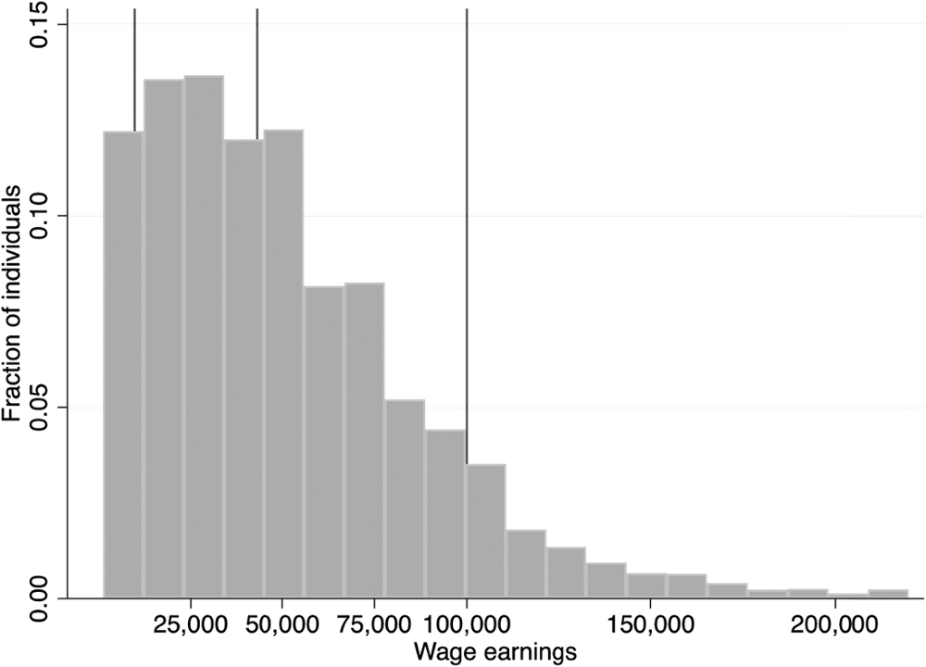
Preliminary Explorations of Labour Market Outcomes
Figure 1.1 The Distribution of Individual Labour Earnings, 2017
© 2021 MCGRAW-HILL EDUCATION LIMITED.
1-<number>

Slide 14
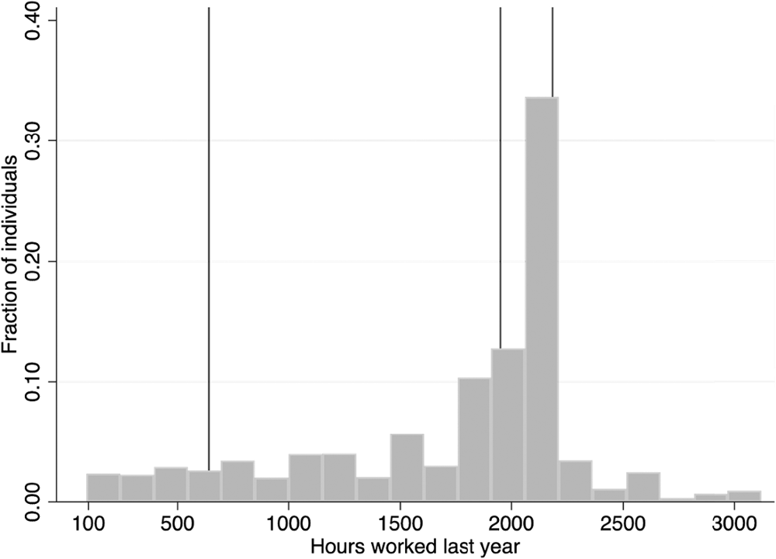
Preliminary Explorations of Labour Market Outcomes
Figure 1.2 The Distribution of Individual Annual Hours Worked, 2017
© 2021 MCGRAW-HILL EDUCATION LIMITED.
1-<number>

Slide 15
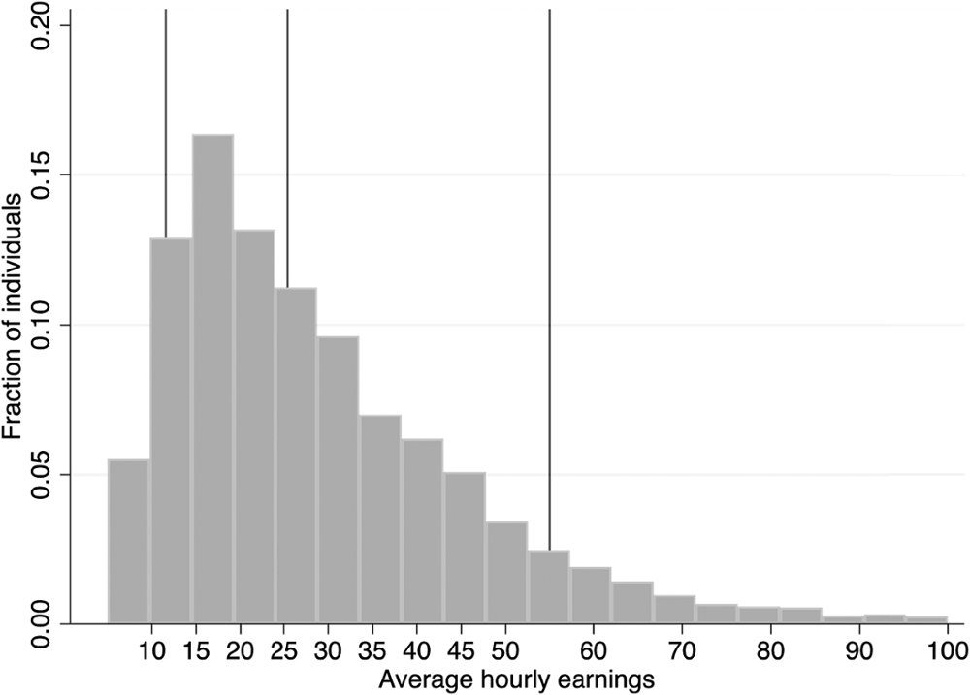
Preliminary Explorations of Labour Market Outcomes
Figure 1.3 The Distribution of Individual Average Hourly Earnings (Wages), 2017
© 2021 MCGRAW-HILL EDUCATION LIMITED.
1-<number>

Slide 16
The Neoclassical Model of
Labour Supply and Demand
Key Ingredients:
Behavioural assumptions about how buyers and sellers respond to prices and other factors.
Assumptions about how buyers and sellers interact, and how the market determines the level and terms of exchange.
© 2021 MCGRAW-HILL EDUCATION LIMITED.
1-<number>

Slide 17
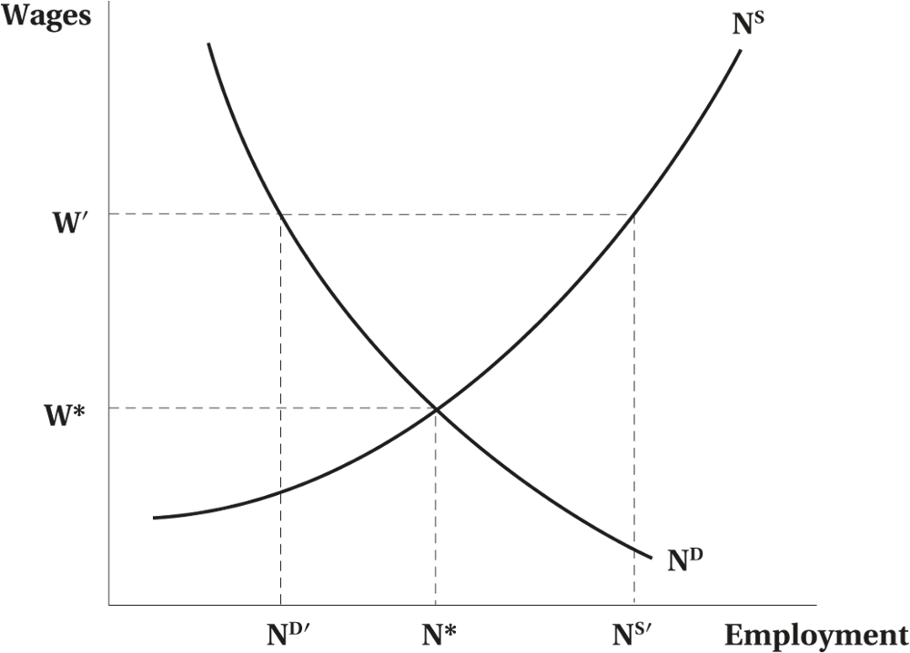
Wages and Employment in a Competitive Labour Market
Figure 1.4 Wages and Employment in a Competitive Labour Market
© 2021 MCGRAW-HILL EDUCATION LIMITED.
1-<number>

Slide 18
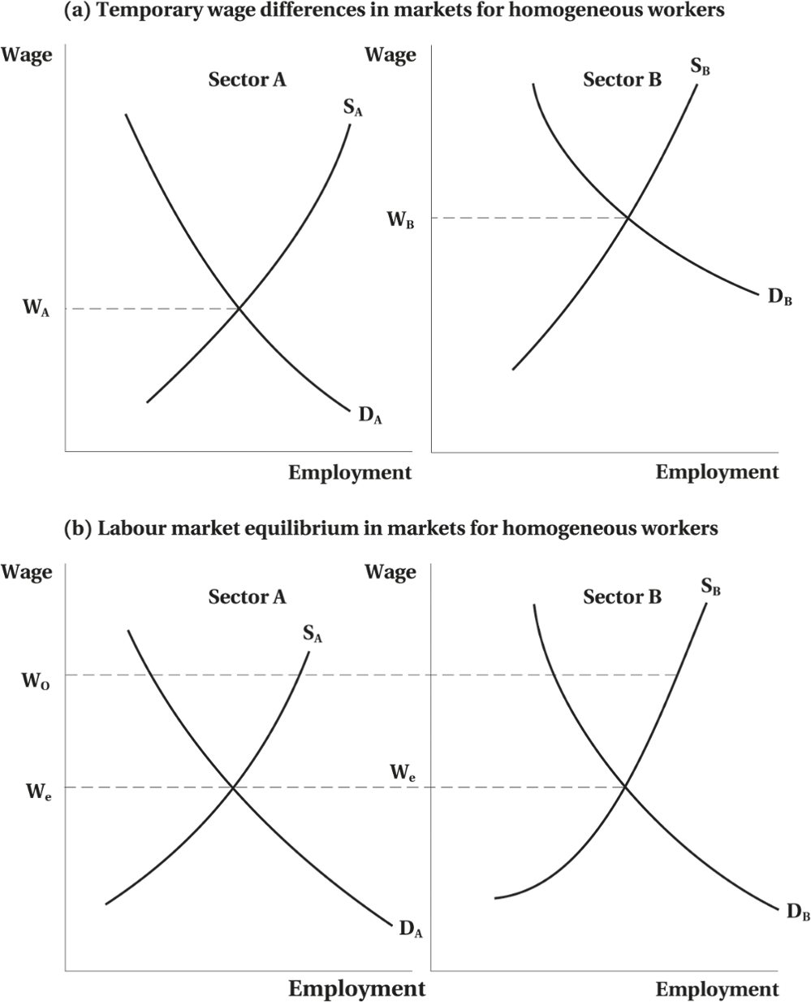
Wages and Employment in a Competitive Labour Market
Figure 1.5 Equilibrium Wages across Two Sectors
© 2021 MCGRAW-HILL EDUCATION LIMITED.
1-<number>

Slide 19
Current Policy Issues
Labour market economics should be able to shed light on policy issues affecting:
    Labour Supply
    Labour Demand
    Wage Determination and Wage Structures
    Unemployment
© 2021 MCGRAW-HILL EDUCATION LIMITED.
1-<number>

Slide 20
Current Policy Issues
Labour Supply:
Work incentive effects of income maintenance and tax transfer programs such as employment insurance, welfare, subsidized day care…
Labour Demand:
The labour demand effects of globalization and outsourcing, trade policies, collective bargaining, legislative policies with respect to minimum wages, human rights, workplace health and safety…
© 2021 MCGRAW-HILL EDUCATION LIMITED.
1-<number>

Slide 21
Current Policy Issues
Wage Determination and Wage Structures:
Wage polarization, non-wage benefits, male-female wage differentials, pay equity legislation, retirement, and pensions…
Unemployment:
Changes in unemployment rate, job stability, impact of employment insurance on unemployment, youth unemployment…
© 2021 MCGRAW-HILL EDUCATION LIMITED.
1-<number>

Slide 22
COVID-19 and the Labour Market
COVID-19 would have a profound impact on the labour market, at least in the short run.
Many workers were laid off and could not work from home.
Others had their hours increase to deal with changes emanating from the pandemic.
Many parents without childcare were unable to continue working their usual hours and were laid off as a result.
© 2021 MCGRAW-HILL EDUCATION LIMITED.
1-<number>

Slide 23
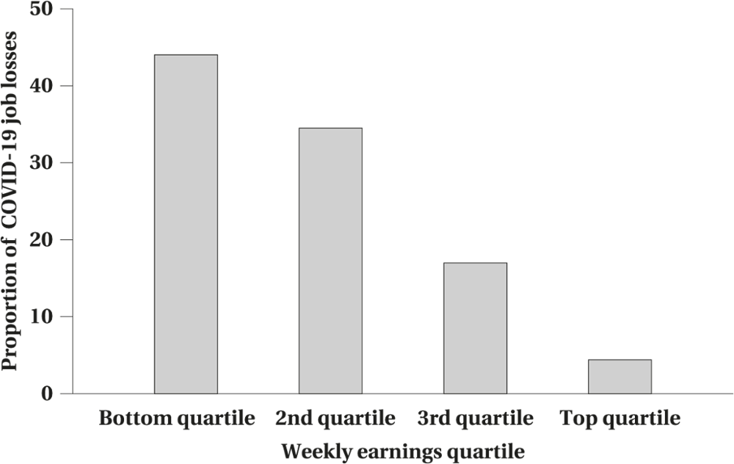
COVID-19 and the Labour Market
Figure 1.6 The Distribution of COVID-19 Employment Losses Across Earning Quartiles
© 2021 MCGRAW-HILL EDUCATION LIMITED.
1-<number>

Slide 24
Similarities and Differences between the Labour Market and Other Markets
Various Actors with a Variety of Goals
Sociological, Institutional, and Legislative Constraints
Market Imperfections
Complex Price, Serving a Variety of Functions
© 2021 MCGRAW-HILL EDUCATION LIMITED.
1-<number>

Slide 25
Chapter Summary
There are three main groups of actors in the labour market: individuals, firms, and government.
While there are many dimensions to the decisions made by these actors, we can distill the outcomes of the decisions to individual outcomes, especially concerning earnings, employment (or hours), and wages.
The neoclassical supply and demand model is a powerful tool that can be used to analyze these outcomes, especially employment and wages.
Most of this book is organized around the supply and demand framework.
© 2021 MCGRAW-HILL EDUCATION LIMITED.
1-<number>

Slide 26
Appendix 1A
REGRESSION ANALYSIS AND RESEARCH DESIGNS

Slide 27
Types of Data
Aggregate or Time-series Data
Cross-section Microdata
Panel or Longitudinal data
© 2021 MCGRAW-HILL EDUCATION LIMITED.
1-<number>

Slide 28
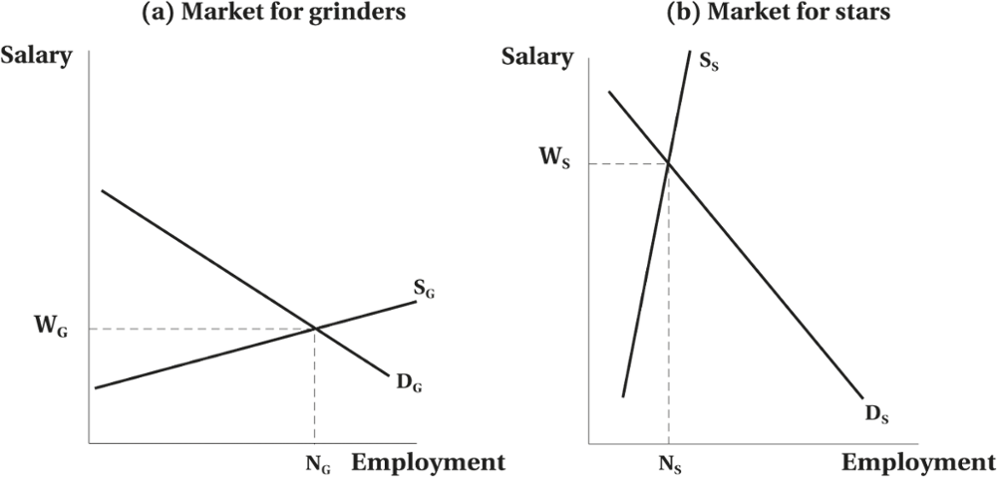
Supply and Demand and the Relative Earnings of “Star” versus “Grinder” Hockey Players
Figure 1.A1 Supply and Demand and the Relative Earnings of Star versus Grinder Hockey Players
© 2021 MCGRAW-HILL EDUCATION LIMITED.
1-<number>

Slide 29
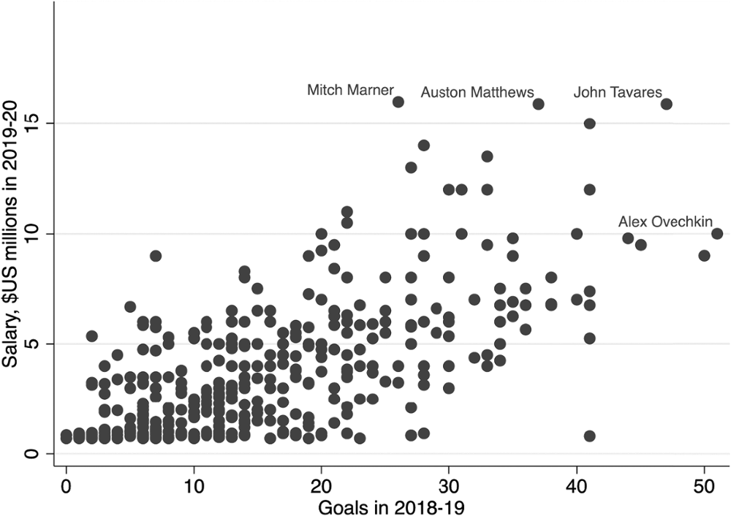
NHL Player Salaries by Goals Scored in the Previous Year, 2018–19
Figure 1.A2 NHL Player Salaries by Goals Scored in the Previous Year
© 2021 MCGRAW-HILL EDUCATION LIMITED.
1-<number>

Slide 30
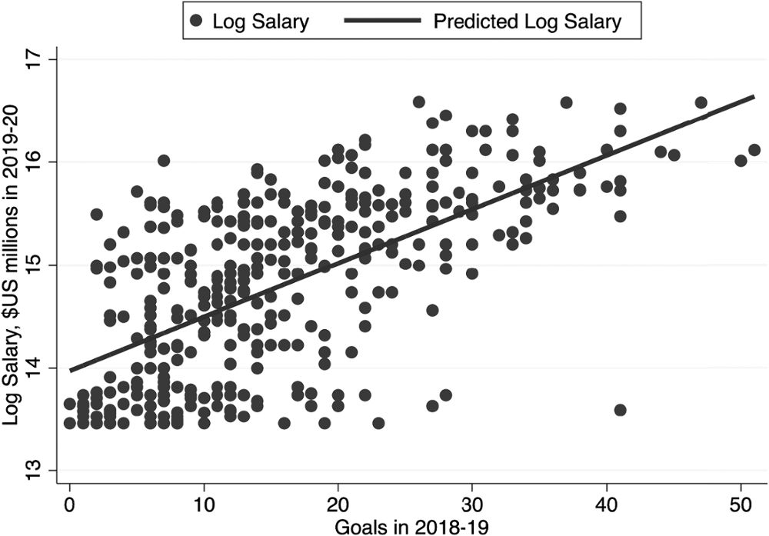
Logarithm of NHL Player Salaries by Goals Scored in the Previous Year, and Fitted Regression Line, 2018–19
Figure 1.A3 Logarithm of NHL Player Salaries by Goals Scored in the Previous Year, and Fitted Regression Line
© 2021 MCGRAW-HILL EDUCATION LIMITED.
1-<number>

Slide 31
Estimating Effects of Performance on Player Salary in 2015–16
We can summarize the relationship between player’s salary and goals as follows:
Salary = a + b x Goals
Salary = a + b x Goals + e
Ordinary Least Square (OLS) estimator
© 2021 MCGRAW-HILL EDUCATION LIMITED.
1-<number>

Slide 32
Tabulation of NHL Player Salaries by Goals Scored, 2018–19
TABLE 1.A1: Tabulation of NHL Player Salaries by Goals Scored, 2018–2019
Goals Scored, 2018–2019 | Sample Size | Salary ($US millions) | In (Salary)
0–9 | 121 | 1.93 | 14.20
10–19 | 133 | 3.13 | 14.73
20–29 | 76 | 5.53 | 15.32
30–39 | 32 | 7.51 | 15.76
40–49 | 11 | 9.03 | 15.82
50 + | 2 | 9.50 | 16.07
© 2021 MCGRAW-HILL EDUCATION LIMITED.
1-<number>

Slide 33
Estimated Effects of Performance on Player Salary in 2019–20 (OLS)
TABLE 1.A2 Estimated Effects of Performance on Player Salary in 2019–2020 (standard errors in parentheses)
 |  | Salary ($US) mean = 3,807,829 |  |  | ln (Salary) mean = 14.81
 | Means | (1) | (2) | (3) | (4) | (5) | (6)
Intercept |  | 685,592 | 247,395 | 197,563 | 13.972 | 13.867 | 13.859
 |  | (218,701) | (202,844) | (211,570) | (0.064) | (0.062) | (0.064)
Goals | 15.97 | 195,498 | 88,605 | 90,550 | 0.052 | 0.027 | 0.027
 |  | (11,468) | (15,469) | (15,651) | (0.003) | (0.005) | (0.005)
Assists | 21.84 |  | 98,218 | 98,902 |  | 0.024 | 0.024
 |  |  | (10,569) | (10,605) |  | (0.003) | (0.003)
Plus/minus | −0.47 |  |  | −8,156 |  |  | −0.001
 |  |  |  | (9,796) |  |  | (0.003)
R-squared |  | 0.44 | 0.54 | 0.54 | 0.39 | 0.47 | 0.47
© 2021 MCGRAW-HILL EDUCATION LIMITED.
1-<number>

Slide 34
Appendix 1B
RESEARCH DESIGNS IN LABOUR ECONOMICS

Slide 35
Research Designs
Empirical Strategies for Estimating the Counterfactual Outcomes
The Distinction between Experimental and Non-experimental Methods
© 2021 MCGRAW-HILL EDUCATION LIMITED.
1-<number>

Slide 36
Experimental Method
Involve random assignment to “treatment” and “control” groups.
Have two advantages
  The statistical techniques needed are very simple and do not require additional assumptions.
  These methods are easy to explain to, and be understood by, policymakers and the general public.
© 2021 MCGRAW-HILL EDUCATION LIMITED.
1-<number>

Slide 37
Non-Experimental Method
Multiple regression is also often needed to control for potentially confounding factors.
  Before–after comparison of those treated
  Post-treatment comparison of treated and comparison groups
  Difference-in-differences: before–after comparison with a comparison group
  Natural experiments (or quasi-experiments)
  Regression discontinuity designs
© 2021 MCGRAW-HILL EDUCATION LIMITED.
1-<number>

